Slide 1
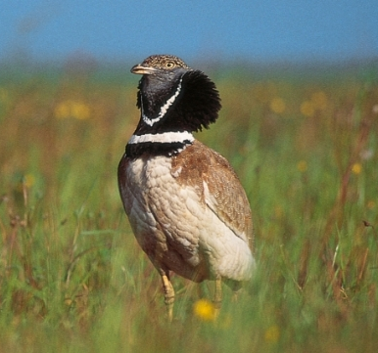
Consequences of rising temperatures on lekking behavior of little bustards (Tetrax tetrax)
Tabitha Jew

Slide 2
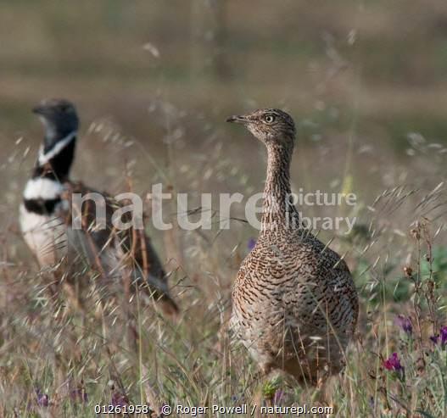
Concerning effects of climate change
My question: How are the rising temperatures effecting lekking behavior?
Importance
More effects of climate change emerge over time
High temperatures can affect survival, breeding activity, food availability
Researching impacts on animals and their habitats helps understand these consequences
Can help predict future consequences

Slide 3
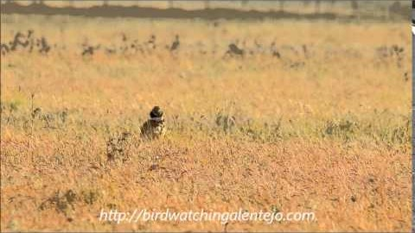
About the little BUSTARD
Physical features
Sexual dimorphism
Bilateral symmetry
Reproduction
Lek mating system
Males jump and flap wings
Produces a “snort-call” to attract females
No male parental care
Chicks are relatively independent

Slide 4
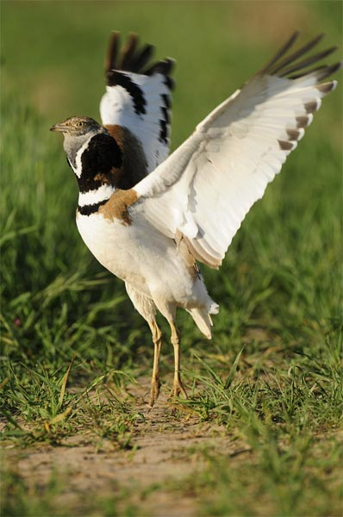
About the little BUSTARD
Habitat
Dry, open grassland or savanna
Can also inhabit agricultural land
Range
Used to inhabit from Portugal to Northwest of China
Now extinct in many countries
Two distinct breeding populations remain
https://www.birdinginspain.com/birding-phototrip/photographing-little-bustard.html

Slide 5
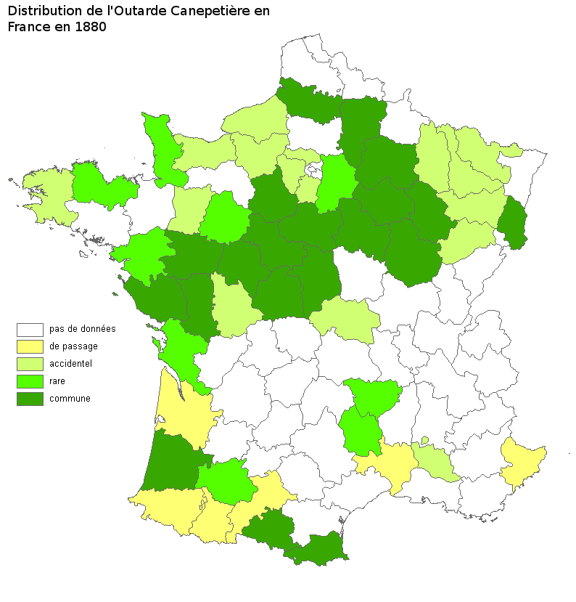
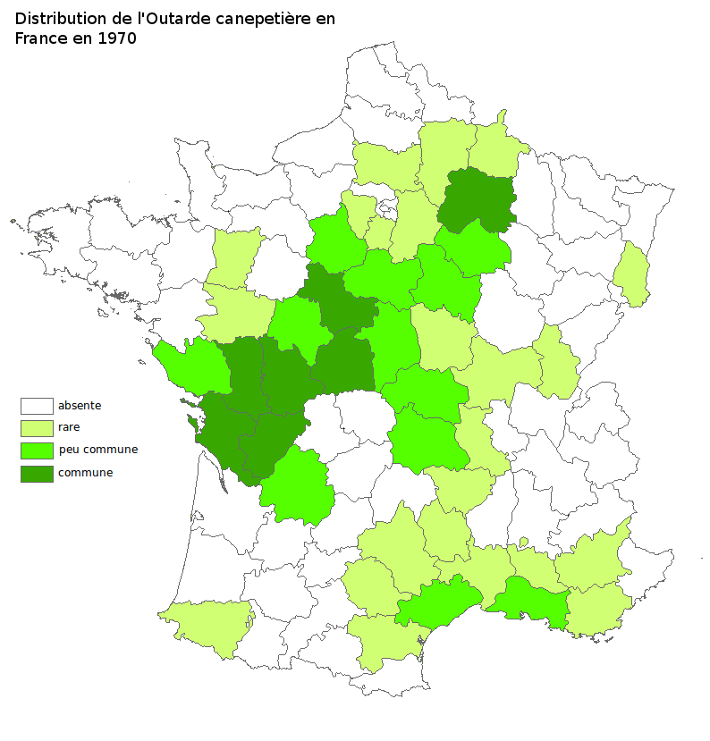
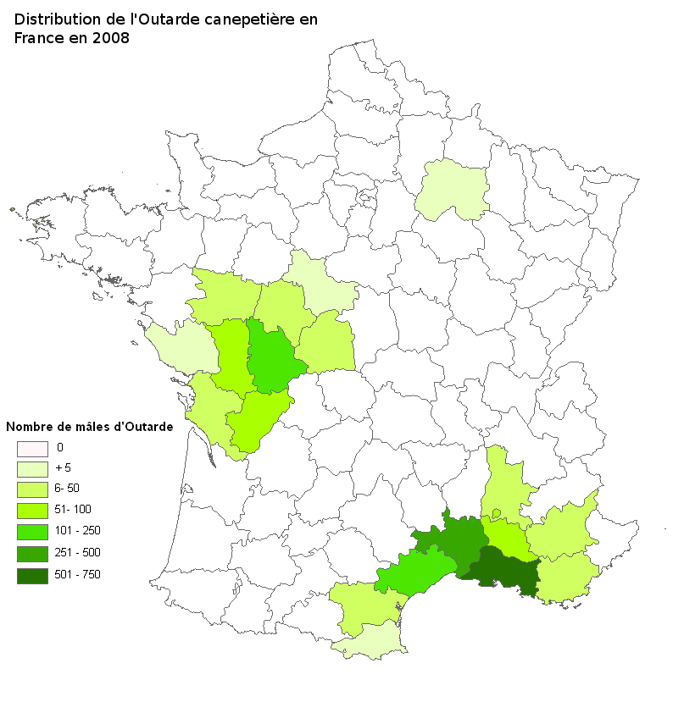
Range of little BUSTARD in France
1880
1970
2008

Slide 6
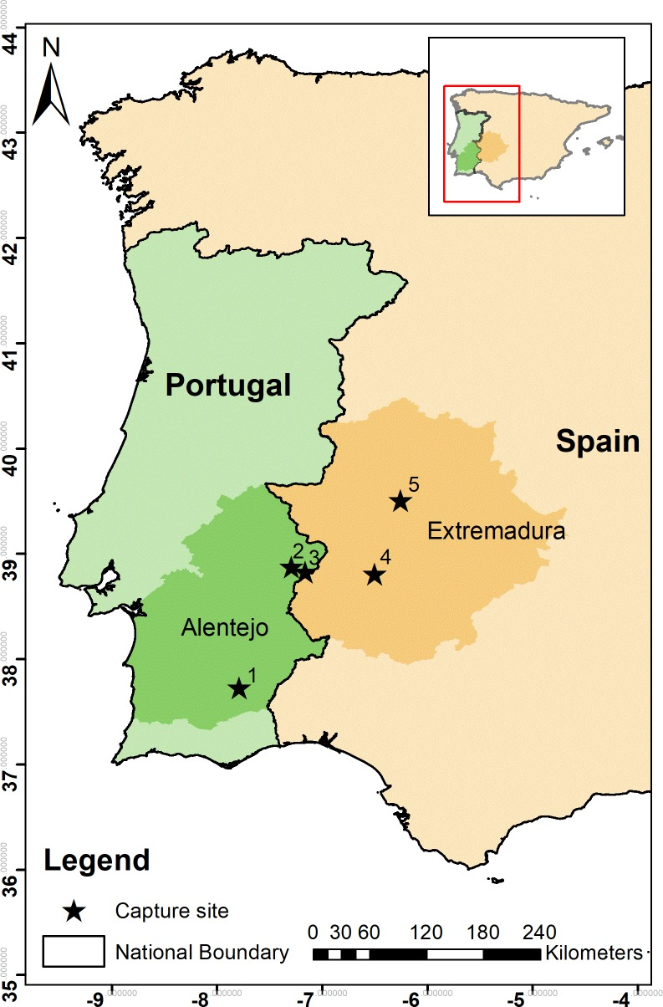
Feeling the heat: Elevated temperature affects male display activity of a lekking grassland bird. Gudka M, Santos CD, Dolman PM, Abad-Gómez JM, Silva JP.
Hypothesis: High temperatures would be the limiting factor in male snort-calling and display activity
Methods
Study took place in regions in Portugal and Spain
Capture using snares
17 birds were fitted with GPS and accelerometer devices
Ambient temperatures measured every hour

Slide 7
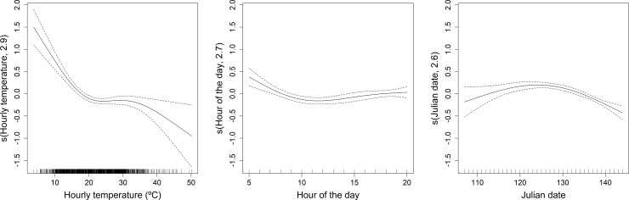
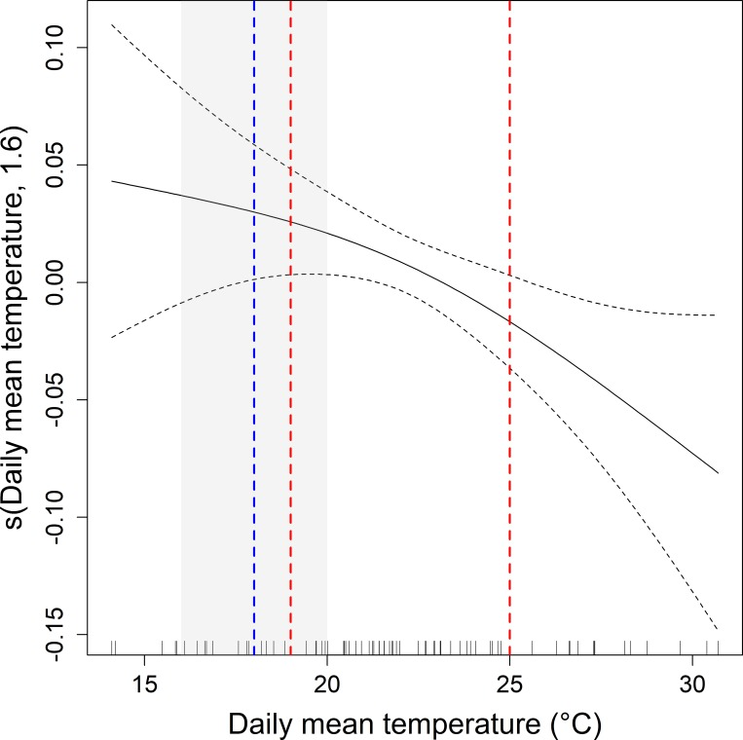
Models of Collected Little Bustard Data
Collected a total of 8308 accelerometer sequences
Average daily daytime temperatures: 10°C – 31°C
April-May of 2014/2015
Created models to show probability of male mating behavior
Hourly temperature
Daily mean temperature
Time of day
Julian date

Slide 8
Discussion of Results
Based on the IPCC projections, there will be 1°C to 7°C temperature increases for Southern Europe/Mediterranean region
Important because little bustards are related to daytime average temperatures
These increases in temperature are likely to further decreases in display activity
Reduced active time of the lek
Less mating opportunities
May push little bustards to become extinct in even more countries

Slide 9
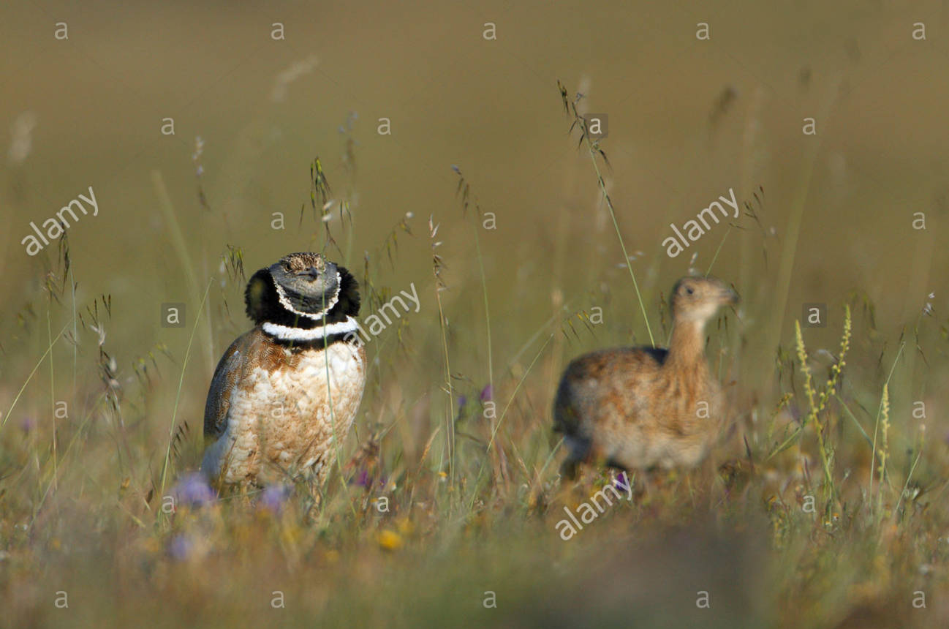
Conclusion
It is still unknown whether conservation efforts through captive breeding is helping this species or not due to lack of funds.
Future research may include how little bustards are behaviorally adapting to modern agricultural methods destroying favorable habitats
A wide range of lekking animals may be vulnerable to increased temperatures. These studies can help predict how to conserve other species

Slide 10
Literature Cited
Gudka M, Santos CD, Dolman PM, Abad-Gómez JM, Silva JP. Feeling the heat: Elevated temperature affects male display activity of a lekking grassland bird. PloS one. [updated 2019 Sep 16; accessed 2020 Nov 8]. https://www.ncbi.nlm.nih.gov/pmc/articles/PMC6746384/
M. Juhlin C. Climate change impact on grassland birds in the Mediterranean basin: a case study with the Little Bustard. Lund University. [updated 2018 Oct 15; accessed 2020 Nov 8]. https://lup.lub.lu.se/student- papers/search/publication/8960271/
Ponjoan A, Bota G, Mañosa S. 2012. Ranging behaviour of little bustard males, Tetrax tetrax, in the lekking grounds. Behav Processes. [updated 2012 May 22, accessed 2020 Nov 8]. https://pubmed.ncbi.nlm.nih.gov/22626823/
All about the endangered Little Bustard in France. Planetepassion.eu. [accessed 2020 Nov 8]. http://www.planetepassion.eu/BIRDS-IN-FRANCE/Little-Bustard-Tetrax-tetrax-Outarde-conservation- france.html

